Slide 1

Task 3.1 State-of-the-Art, Threat model and Technical Specifications
WP3 Third Meeting
20 02 2025
ICCS

Slide 2
Collaborative Model Paradigm

Slide 3
Federated Learning

Slide 4
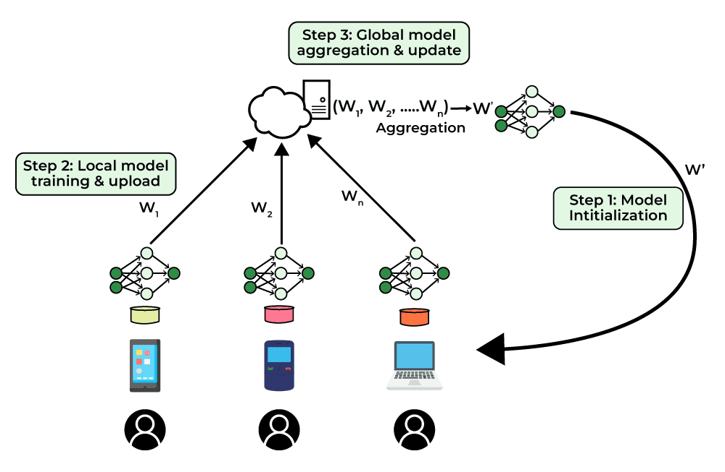
Federated Learning - Overview
Federated Learning (FL) is a machine learning technique that enables multiple devices or servers to train a shared model without sharing their data.
Instead of sending raw data to a central server, each device trains a local model on its own data and then shares only the model updates (such as gradients or weights) with a central coordinator. This makes FL privacy-preserving, efficient, and scalable.

Slide 5
Threat models of FL
Although the original intention of FL is to prevent data sharing and achieve strict privacy protection, privacy and security issues still exist.
In terms of security:
attacks are often focused on integrity and availability. Threats to integrity and availability mainly focus on the output of the machine learning model, which can seriously affect the regular use of the model.
In terms of privacy:
attackers tend to focus on confidentiality. For confidentiality, attackers can expose the target model information and the prediction results. According to existing research, privacy-preserving algorithms can still put user privacy at risk.

Slide 6
Threat models of FL
Insider vs. Outsider
Client vs. Server
Attacker capabilities
Honest‑but‑curious vs. malicious
Training phase vs. Inference phase

Slide 7
Federated Learning
Security Attacks

Slide 8
Security Attacks
Untargeted
Targeted

Slide 9
Security Attacks – Untargeted
In the context of FL, an undirected attack refers to an attacker’s objective of causing damage or disruption to the entire FL system, without specifically targeting a particular model, participant, or task.
Attackers employ various methods to achieve their goals, including tampering with or injecting malicious data to disrupt participants’ training processes and modifying participant models to degrade the overall performance of the federated model.

Slide 10
Security Attacks – Untargeted
Byzantine Attacks
Refers to the intentional malicious actions taken by attackers to undermine the security and reliability of the federated learning system.
These actions involve sending false, incorrect, or intrusive data, model parameters, or aggregation gradient updates during the training phase. These updates can mislead the aggregation process, degrade the global model's performance, or even introduce vulnerabilities.

Slide 11
Security Attacks – Targeted
Directed attack in federated learning refers to a malicious attack specifically targeted at particular participants or tasks, with the intention of interfering, destroying, or manipulating the performance of the model training process or the models of specific participants.
In contrast to undirected attacks, targeted attacks are more focused and specific, where attackers have clear goals or motives and employ tailored measures to disrupt specific participants or tasks.

Slide 12
Security Attacks – Targeted
Poisoning Attack
A poisoning attack is an attempt by an attacker in FL to corrupt the overall model generation by inserting "toxic" data into the model during the training phase.
An attacker can modify or delete their original training data, resulting in an absence of the original data distribution, or replace it with the original data, disrupting the functional implementation of the model.
Depending on which part of the client’s information is poisoned:
data-poisoning
model-poisoning

Slide 13
Security Attacks – Targeted
Data Poisoning
The attacker is assumed to have access to the training data of one or more clients and to be able to modify it.

Slide 14
Security Attacks – Targeted
Model Poisoning
These attacks consist of directly poisoning the model updates sent by the clients to the server.

Slide 15
Federated Learning
Privacy Attacks

Slide 16
Privacy Attacks
Privacy attacks are designed to disclose information about the participants of a machine learning task.

Slide 17
Privacy Attacks
Membership Inference Attacks
Model Inversion Attacks
Feature Inference Attacks (Reconstruction or Gradient Inversion Attacks)
Property Inference Attacks (Attribute Inference Attacks)

Slide 18
Privacy Attacks
Membership Inference Attacks
An attacker tries to determine whether a specific data sample was used in training a FL model. This can be a serious privacy risk, especially in sensitive applications like healthcare, finance, or autonomous driving.

Slide 19
Privacy Attacks
Model Inversion Attacks
An attacker tries to reconstruct sensitive training data by exploiting access to the trained FL model. This attack can be used to extract private information, such as images, medical records, or personal details, just by analyzing the model’s outputs.

Slide 20
Privacy Attacks
Feature Inference Attacks
An attacker tries to recover private features of the training data by exploiting model updates (gradients) in FL.
Instead of trying to extract full data samples, the attacker focuses on reconstructing specific features from the gradients shared during training.

Slide 21
Privacy Attacks
Property Inference Attacks
An attacker tries to infer specific attributes or properties of the training data without directly accessing it.
In FL, this can happen when an attacker uses the model’s predictions or updates to deduce sensitive attributes associated with the users in the training dataset.

Slide 22
Privacy Attacks
Property Inference Attacks
The attacker observes the model’s behavior to infer general properties of the training set
Focus on general properties of the entire dataset (vs. feature Inference attacks that focus on specific attributes of individual records)

Slide 23
Next Steps
Threats/Use Cases (WIP)
T3.1_ Living Document (update)

